Slide 1
Hypertensive Disorders of Px
Complicate up to 10 percent of pregnancy
As a group, they are one member of the deadly triad—along with hemorrhage and infection
Most hypertension-related deaths are deemed preventable

Slide 2
To codify the classification of hypertensive disorders of pregnancy, the American College of Obstetricians and Gynecologists (2013, 2020) describes four types of hypertensive disease:
1. Preeclampsia and eclampsia syndrome
2. Chronic hypertension of any etiology
3. Preeclampsia superimposed on chronic hypertension
4. Gestational hypertension, in which definitive evidence for the preeclampsia syndrome does not develop and hypertension resolves by 12 weeks postpartum.

Slide 3
Gestational Hypertension
Women with gestational hypertension have blood pressures that reach 140/90 mm Hg or greater for the first time after midpregnancy but lack proteinuria.
Almost half of affected women subsequently develop preeclampsia
Even so, when blood pressure rises appreciably, it is dangerous to both mother and fetus to ignore this elevation only because proteinuria has not yet developed
10 percent of eclamptic seizures develop before overt proteinuria can be detected

Slide 4
Preeclampsia Syndrome
Preeclampsia is best described as a pregnancy-specific syndrome that can affect virtually every organ system
Proteinuria is an objective marker and reflects the system-wide endothelial leak that characterizes the preeclampsia syndrome.
Last, preeclampsia can be divided into early onset, <34 weeks; late onset, ≥34 week

Slide 5
Gestational Proteinuria
It is generally agreed that urine dipstick protein measurements should be performed at each prenatal visit after 20 weeks’ gestation.
Gestational proteinuria is defined as
urinary protein excretion of at least 300 mg per 24-hour timed collection,
P/C ratio greater than 0.3, or persistent proteinuria (≥1+ on dipstick on at least two occasions at least 4 hr apart)

Slide 6
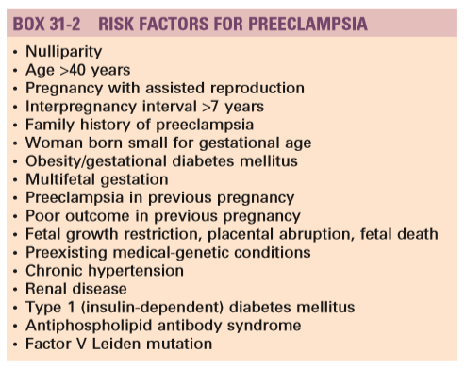

Slide 7
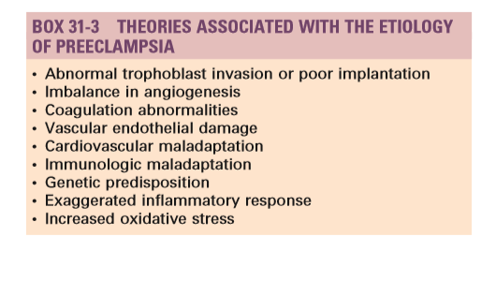
Generally, PE is considered a disease of primigravid women.

Slide 8

It is recommended that all BP values be recorded with the woman in a sitting position for ambulatory patients or in a semi reclining position for hospitalized patients
The right arm should be used consistently, and the arm should be in a roughly horizontal position at heart level.

Slide 9
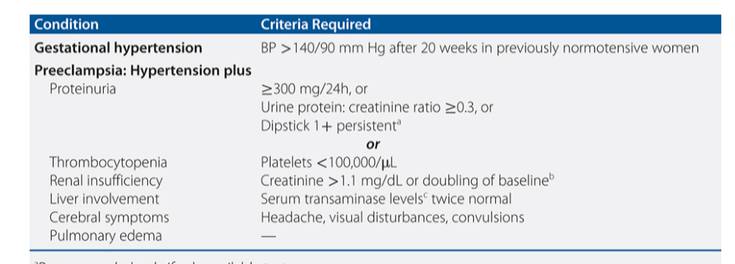

Slide 10
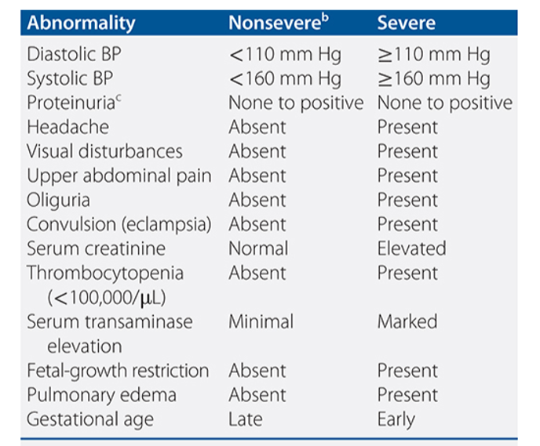
Indicators of severity

Slide 11
Preeclampsia Superimposed on Chronic Hypertension
In 20 to 50 percent of women with chronic hypertension, blood pressure rises to obviously abnormal levels, typically after 24 weeks’ gestation.

Slide 12
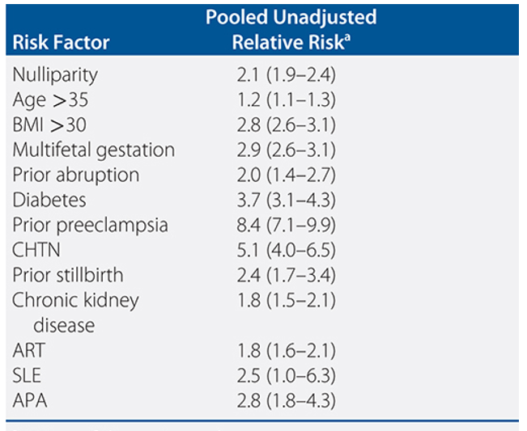
Selected risk factors for preeclalmsia

Slide 13
National guideline
Hypertensive disorders of pregnancy (HDP) is the second most common cause of maternal deaths.
HDP is also one of the most common causes of premature delivery and perinatal mortality.

Slide 14
National guideline
Dietary counseling of pregnant women should promote adequate calcium intake
The recommended daily calcium supplementation is 1.5–2.0 g oral elemental calcium starting from 14 weeks of gestation.
Low dose aspirin is recommended for prevention of pre-eclampsia in women at high risk of developing pre-eclampsia.

Slide 15
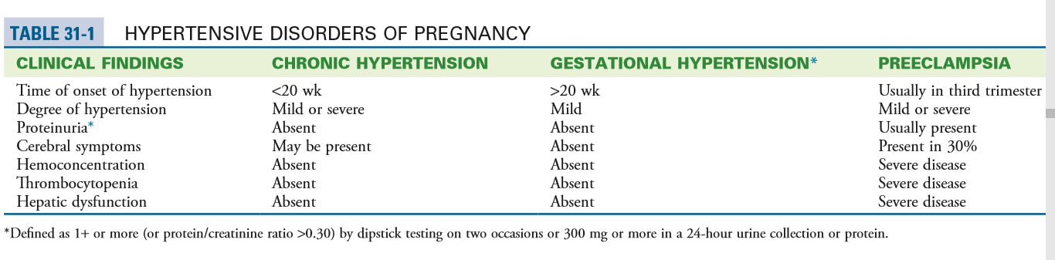
PATHOPHYSIOLOGY

Slide 16
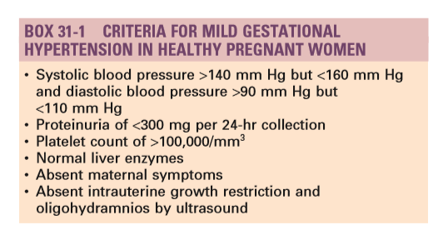

Slide 17
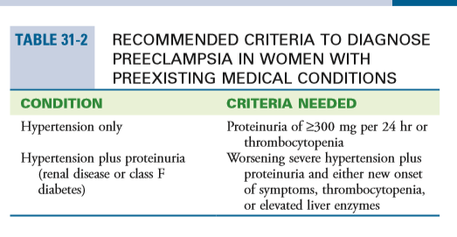

Slide 18
HYPERTENSION OR PREECLAMPSIA WITHOUT SEVERE FEATURES
women with disease that develops at 37 weeks’ gestation or later should undergo induction of labor.
Those who are managed as outpatients are also advised on danger symptoms

Slide 19
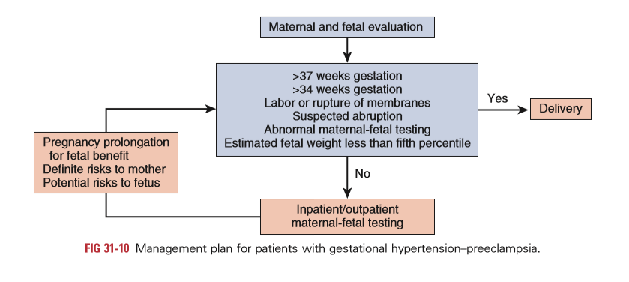

Slide 20
The onset of maternal symptoms and/or a sudden increase in BP to severe values requires prompt hospitalization for close evaluation.
In women with PE at less than 37 weeks’ gestation but at more than 32 weeks, outpatient management can be considered for reliable patients with a systolic BP of 155 mm Hg or less or diastolic BP of 105 mm Hg or less and no symptoms.

Slide 21
PREECLAMPSIA WITH SEVERE FEATURE
The incidence of preeclampsia with severe features ranges from 0.6% to 1%.
Pregnancies complicated by pe with severe features are associated with serious maternal and perinatal complications, particularly preterm delivery, fgr, placental abruption, and perinatal death
These pregnancies have been associated with increased rates of maternal morbidity and mortality and with significant risks for the fetus (growth restriction, hypoxemia, and death), it is generally agreed that all such patients should be delivered if the disease develops after 34 weeks’ gestation

Slide 22
Prompt delivery is indicated when
Eclampsia is imminent
Persistent, severe symptoms do not respond to treatment
Presence of multiorgan dysfunction
Severe IUGR (<5th percentile) with abnormal umbilical artery doppler studies, such as reversed end-diastolic flow (REDF) or
Severe oligohydramnios (largest vertical pocket <2 cm),
Non reassuring fetal testing

Slide 23
During expectant management, women should be aware that the decision to continue such management will be made on a daily basis and that the median time of pregnancy prolongation is 7 days with a range of 2 to 35 days.

Slide 24
Recommended Management of Preeclampsia With Severe Features
The presence of severe disease mandates immediate hospitalization in labor and delivery.
Iv magnesium sulfate is begun to prevent convulsions,
Antihypertensive medications are administered to lower severe levels of hypertension (systolic pressure ≥160 mm hg and/or diastolic pressure ≥110 mm hg).
The aim of antihypertensive therapy is to keep the systolic pressure between 140 and 155 mm hg and the diastolic pressure between 90 and 105 mm hg

Slide 25
Oral antihypertensives
labetalol of 200 mg every 8 hours to be increased up to 800 mg every 8 hours (600 to 2400 mg/day)
oral nifedipine is added with an initial dose of 10 mg every 6 hours and is subsequently increased up to 20 mg every 4 hours

Slide 26
Severe hypertension
IV hydralazine (25 mg)
Labetalol (300 mg)
IV magnesium sulfate

Slide 27
Laboratory Studies
CBC with platelet count,
Transaminases,
LDH,
Serum creatinine levels.
Coagulation studies are obtained only if thrombocytopenia or suspicion of abruption is present

Slide 28
Control of Severe Hypertension
The objective of treating acute and sustained severe hypertension that lasts more than 60 minutes is to prevent cerebrovascular and cardiovascular complications such as encephalopathy, hemorrhage, and congestive heart failure (CHF) and to prevent retinal injury
Antihypertensive therapy is recommended by some for sustained systolic BP values of 160 mm Hg or more and for sustained diastolic values of 110 mm Hg or more. Some experts recommend treating diastolic levels of 105 mm Hg, and still others use a mean arterial BP of 130 mm Hg or more.1,2 The definition of sustained hypertension is not clear and ranges from 30 minutes to 2 hours

Slide 29
Mode of Delivery
A plan for vaginal delivery should be attempted in all women with disease without other indications for cesarean delivery and in most women with severe disease
No randomized trials have compared the optimal methods of delivery in patients with severe hypertension or severe PE
cesarean delivery is recommended for those with
severe FGR,
severe oligohydramnios,
BPP of 4 or less, or
Reverse umbilical artery Doppler flow at less than 32 weeks of gestation.

Slide 30
PE with severe features is also associated with an increased risk for maternal mortality (0.2%) and increased rates of maternal morbidity (5%), such as convulsions, pulmonary edema, retinal ischemia and injury , acute renal or liver failure, liver hemorrhage, DIC, and stroke.
These complications are usually seen in women who develop PE before 32 weeks’ gestation and in those with preexisting medical conditions

Slide 31
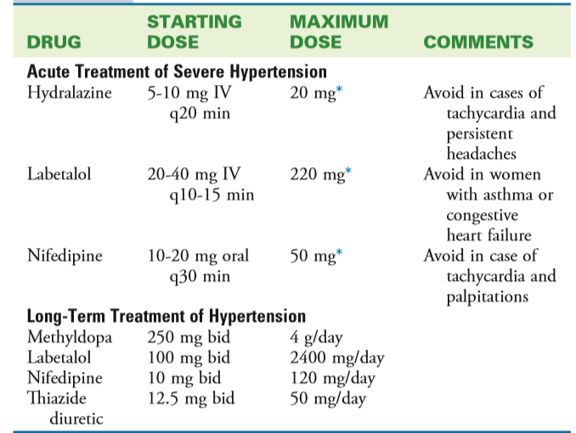

Slide 32
Chronic hypertension
The frequency of chronic hypertension in pregnancy is estimated at 1% to 5%.
Chronic hypertension is defined as elevated bp that is present and documented before conception.
Presence of sustained hypertension before 20 weeks of gestation,

Slide 33
Pregnancies complicated by chronic hypertension are at increased risk for the development of superimposed PE, placental abruption, and fetal growth restriction
Rate of PE in women with severe chronic hypertension ranges from 50% to 79%
The overall rate of superimposed PE was 25%

Slide 34
Thank you

